Slide 1
The untapped medicinal value of Honeybush in the management of diabetes
Kyle Le Roux (MSc Biochemistry)
Notes:
Solid maroon background slide
The ghost text placeholder is fully scalable and movable.
To add a background image:
Right-click on the slide and choose Format Background …
Click on the Picture or texture fill option and click on the Insert button.
Browse and select a picture and click on the Insert button.
Remember to add image attributions to photographs or artworks.

Slide 2
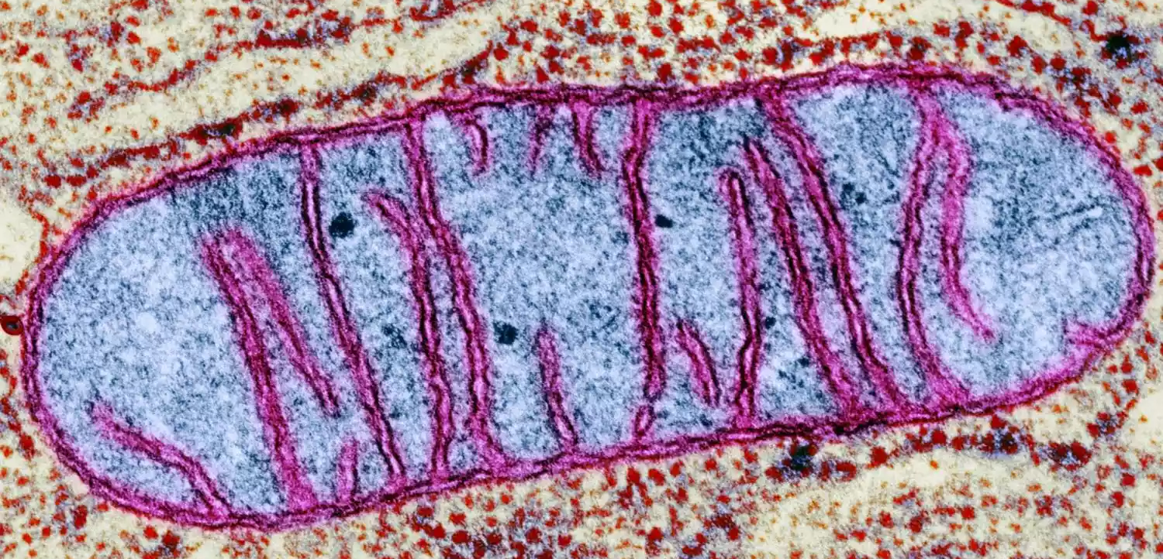
Mitochondrial health and its role in diabetes

Slide 3
Mitochondria are the living furnaces of the cell and antioxidants are its cleaners
Glucose
= fuel
Oxidants = smoke and soot

Slide 4
The healthy scenario
Glucose is used to create energy
Oxidants are produced
Antioxidant defences counter the oxidants
Healthy balance is maintained

Slide 5
The diabetic scenario
High amounts of glucose enters the cells
Excessive Oxidants are produced
Antioxidant defences are overwhelmed
Mitochondria become dysfunctional and complications manifest

Slide 6
Why conventional medicine is not the whole answer
Liver and brain cells carry multiple mitochondria and are the hardest hit by mitochondrial dysfunction
Lowering glucose levels does not account for the damage to the antioxidant defences or the damage before treatment
Conventional medicine requires access to healthcare services, and in many cases is unaffordable

Slide 7
Why indigenous plants have caught the interest of researchers

Slide 8
Can honeybush be the answer?

Slide 9
So far, the results are promising

Slide 10
What these findings could mean for the industry
Honeybush would find an entirely new market in the form of a nutraceutical extract
Harvesting and cultivation of honeybush may change to improve its content, rather than its taste profile
Previously underutilised species may see relevance if proven to be beneficial in the treatment of diabetes
These findings would further support the interest in other indigenous plants

Slide 11
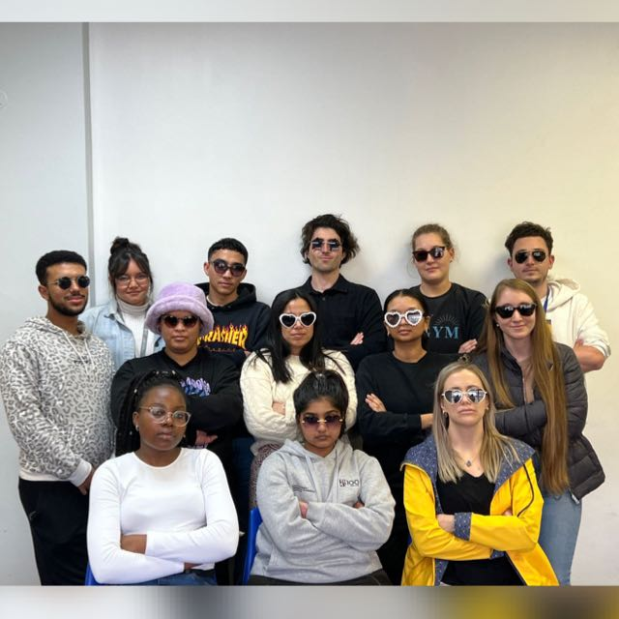
Thank you!

